Slide 1
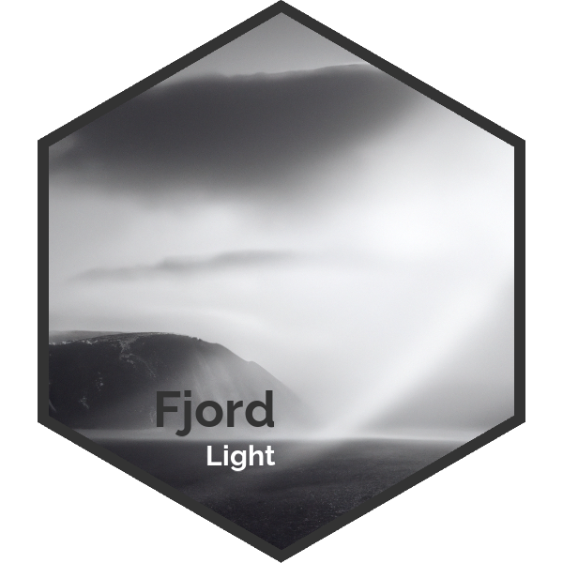
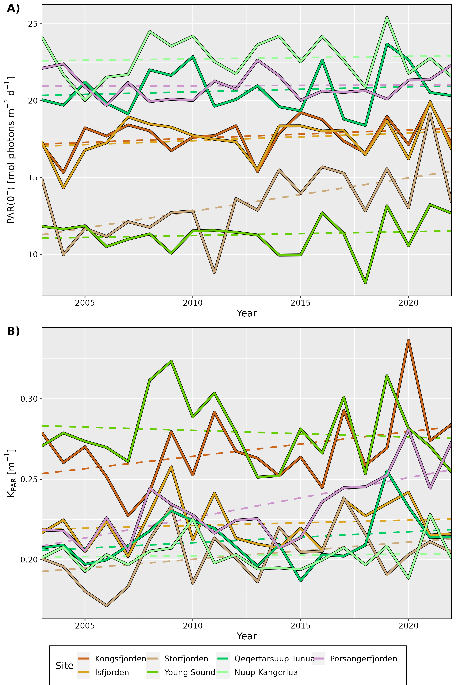

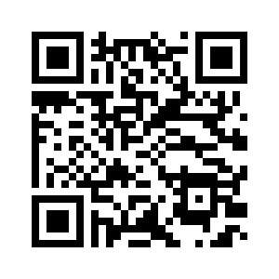
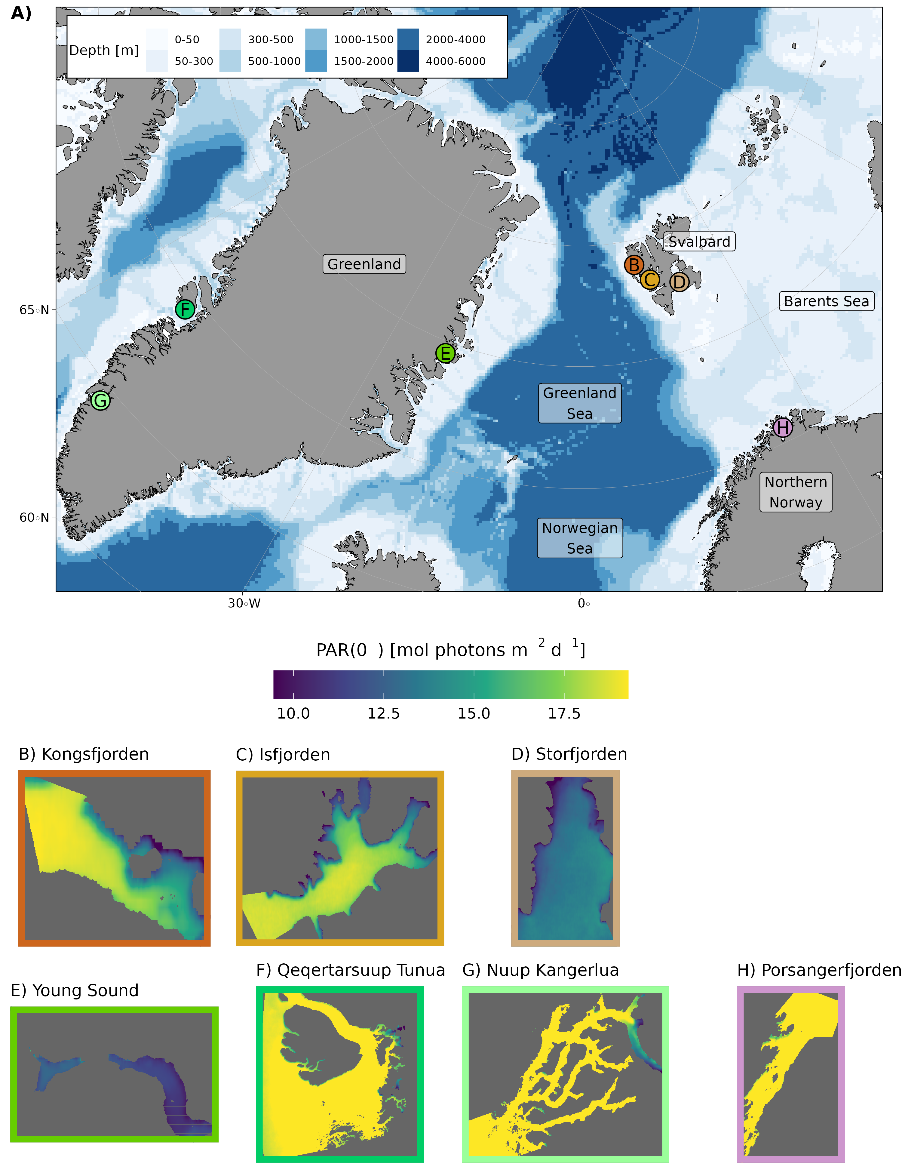
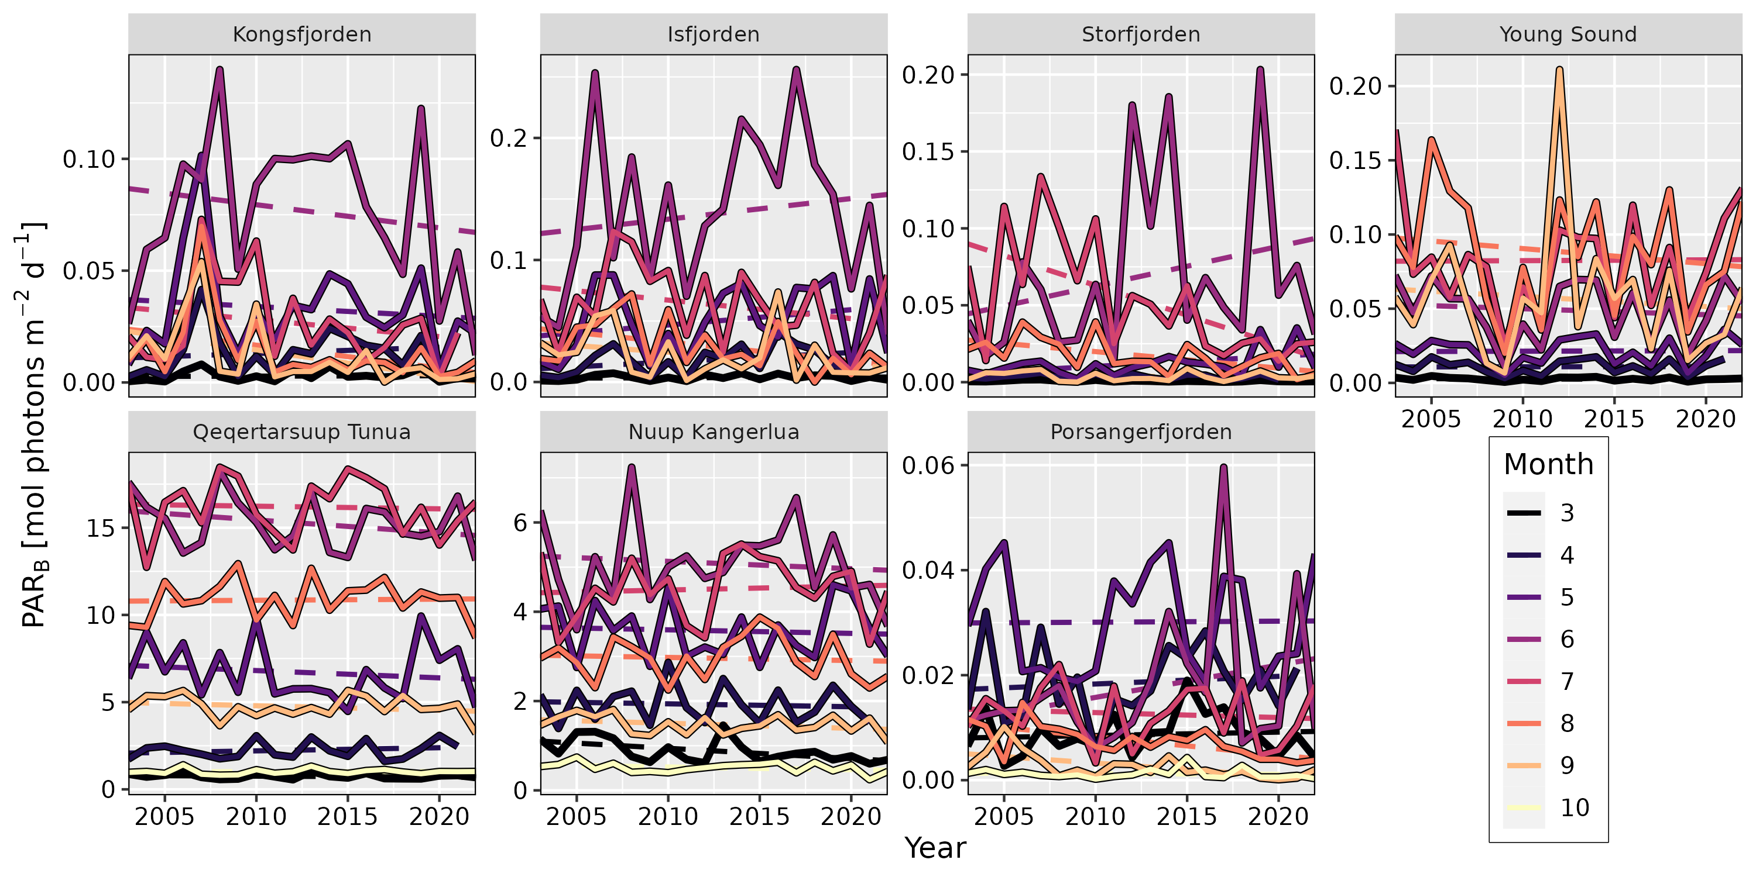
Underwater light environment in Arctic fjords
Robert Schlegel¹, Rakesh Kumar Singh^{2,3}, Bernard Gentili¹,
Simon Bélanger², Laura Castro de la Guardia⁴,
Dorte Krause-Jensen⁵, Cale Miller⁶, Mikael Sejr^{5,7},
Jean-Pierre Gattuso^{1,8}
Scan Me!
Summary
PANGAEA
Temperature and salinity within Arctic fjords is well monitored, but extensive spatial data for their light environments tend to be lacking. This is problematic given the importance of light for life in the benthos and water column. Therefore the FjordLight dataset was developed (Fig. 1), based on existing global datasets (Gattuso et al., 2020; Singh et al. 2022). This high resolution (50-150 m) gridded dataset contains surface photosynthetically available radiation (PAR(0⁻)), diffuse attenuation of PAR through the water column (K_{PAR}), and PAR available at the seafloor (bottom PAR; PAR_{B}) for seven Arctic fjords distributed across Svalbard, Greenland, and Norway, over the period 2003-2022 (Fig. 2). PAR_{B} is available at monthly resolution over this time period, and all three variables are available as global averages, annual averages, and monthly climatologies. The interannual variability of monthly PAR_{B} is generally too large to determine any long term trends, however; in some fjords PAR_{B} has increased in spring and autumn, and decreased in summer (Fig. 3). It is hypothesised that this shift is due to a decrease in seasonal ice cover (i.e. enhanced surface PAR) in the shoulder seasons, and an increase in coastal runoff (i.e. increased turbidity/decreased surface PAR) in summer. The PAR_{B} values in this dataset were combined with known PAR requirements of macroalgae to track the linear change in time of the potential distribution area for macroalgal habitats within fjords. The only significant change (p-value = 0.04) was found in Kongsfjorden at -0.21% habitable area per year.
GitHub
Fig. 2 Time series of the average annual A) surface PAR (PAR(0⁻)) and B) extinction coefficient (K_{PAR}) for each of the seven study sites from 2003-2022. Dashed lines show linear trend.
Fig. 3 Time series of the average monthly bottom PAR (PAR_{B}) for each of the seven study sites from 2003-2022. Dashed lines show linear trend.
Material and Methods
The dataset was created from retrievals of the visual surface of the ocean using MODIS-Aqua Level-1A (L1A), which was then processed to Level-2 via SeaDAS v8. From this, the algorithm from Singh et al. (2022) was used to determine PAR(0⁻) and K_{PAR}. With these two values, the highest resolution bathymetry products available per site (50-150 m) were used to calculate PAR_{B} and interpolate to an even grid at the highest resolution available for that site. An R package was developed to aid in the retrieval and extraction of these data, while the dataset itself was published on PANGAEA.
Fig. 1 A) Map of the EU Arctic showing the location of the seven study sites. B-H) The global surface PAR (PAR(0⁻)) for each of the seven sites. Note that differences in PAR(0⁻) are generally due to differences in sea ice cover.
1 Sorbonne University, CNRS, Laboratoire d’Océanographie de Villefranche, Villefranche-sur-mer, France
2 Département de Biologie, Chimie et Géographie, Université du Québec à Rimouski, Rimouski, QC G5L3A1, Canada
3 Centre for Remote Imaging, Sensing and Processing (CRISP), National University of Singapore, Singapore 119076
4 Norwegian Polar Institute, Fram Centre, Tromsø, Norway
5 Department of Ecoscience, Aarhus University, Aarhus C, Denmark
6 Department of Earth Sciences, Utrecht University, Utrecht, The Netherlands
7 Arctic Research Centre, Aarhus University, Aarhus C, Denmark
8 Institute for Sustainable Development and International Relations (IDDRI-Sciences Po), Paris, France
References
Gattuso, J.-P., Gentili, B., Antoine, D., & Doxaran, D. (2020). Global distribution of photosynthetically available radiation on the seafloor. Earth System Science Data, 12(3), 1697–1709. https://doi.org/10.5194/essd-12-1697-2020
Singh, R. K., Vader, A., Mundy, C. J., Søreide, J. E., Iken, K., Dunton, K. H., Castro de la Guardia, L., Sejr, M. K., & Bélanger, S. (2022). Satellite-Derived Photosynthetically Available Radiation at the Coastal Arctic Seafloor. Remote Sensing, 14(20), Article 20. https://doi.org/10.3390/rs14205180

